Slide 1
Literature Review
GDP of India Forecasting Using Machine Learning and Deep Learning

Slide 2
Project Status
15%
Studied GDP in detail from Wikipedia
and other websites
Overall Completed
Collected Project data from niti.gov.in website
15nos
Created GitHub repository
Datasets collected
13nos
Collected datasets converted to CSV and cleaned
Datasets converted to CSV and Cleaned

Slide 3

Dataset Details
The RAW Data was taken from the financial section that contained the following documents:
Aggregate Expenditure
Aggregate Receipts
Capital Expenditure
Capital Receipts
Fiscal Deficits
Interest Payments
Outstanding Liabilities
Own Tax Revenues
Revenue Deficits
Revenue Receipts
Social Sector Expenditure
Nominal GSDP Series.
The RAW data was in XLSX format which was converted to a well-known CSV format that could be later easily read by python pandas library. The unknown values that were originally represented by a ‘-’ was replaced by NA’s by pandas.

Slide 4
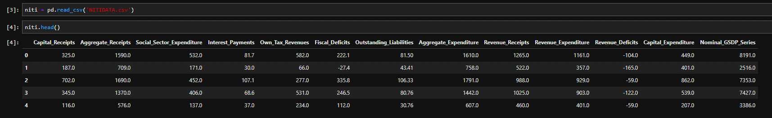
Dataset Details
The Data was given for 29 states and 2 Union Territories, from the year 1981 to 2016, some of the data was missing for some of the states, due to the fact that the data was started to be collected at a later period of time, or maybe the state wasn’t even formed in that year, such years were removed from the data by using remove NA’s in python pandas, and the clean and preprocessed data was dumped to a CSV file.

Slide 5
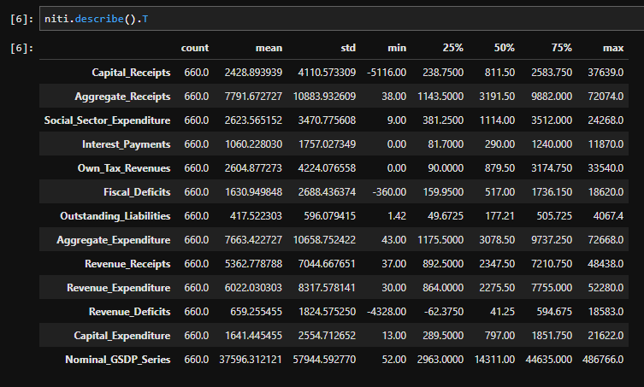
Dataset Details
The total entries in the data described using describe() function
T indicate transposed table*

Slide 6
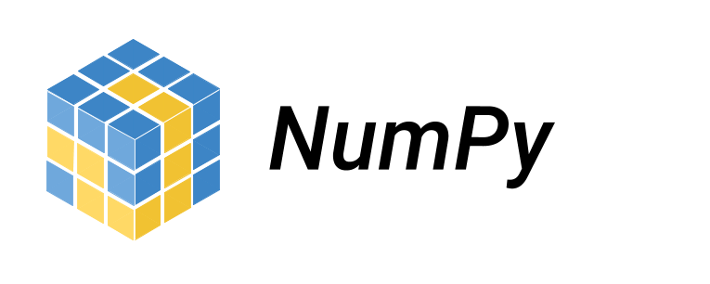
Overview of tools
Numpy
NumPy or sometimes is a library for the Python programming language, adding support for large, multi-dimensional arrays and matrices, along with a large collection of high-level mathematical functions to operate on these arrays. The ancestor of Numpy, Numeric, was originally created by Jim Hugunin with contributions from several other developers. In 2005, Travis Oliphant created Numpy by incorporating features of the competing Numarray into Numeric, with extensive modifications. Numpy is open-source software and has many contributors.
Import numpy as np

Slide 7

Overview of tools
Pandas
In computer programming, pandas is a software library written for the Python programming language for data manipulation and analysis. In particular, it offers data structures and operations for manipulating numerical tables and time series. It is free software released under the three-clause BSD license. The name is derived from the term "panel data", an econometrics term for data sets that include observations over multiple time periods for the same individuals. Its name is a play on the phrase "Python data analysis" itself. Wes McKinney started building what would become pandas at AQR Capital while he was a researcher there from 2007 to 2010.
Import Pandas as pd

Slide 8
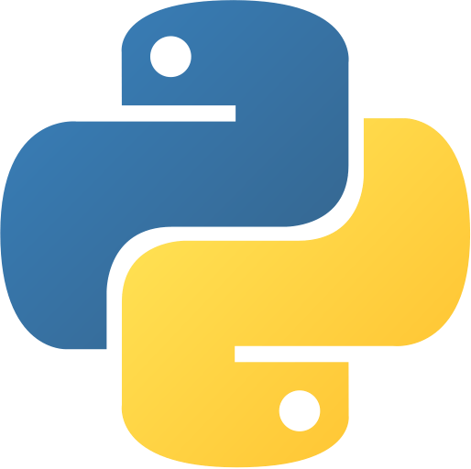
Overview of tools
iPython
IPython (Interactive Python) is a command shell for interactive computing in multiple programming languages, originally developed for the Python programming language, that offers introspection, rich media, shell syntax, tab completion, and history. IPython provides the following features:
Interactive shells (terminal and Qt-based).
A browser-based notebook interface with support for code, text, mathematical expressions, inline plots and other media.
Support for interactive data visualization and use of GUI toolkits.
Flexible, embeddable interpreters to load into one's own projects.
Tools for parallel computing

Slide 9

Overview of tools
Jupyter notebook
JupyterLab is a web-based interactive development environment for Jupyter notebooks, code, and data. JupyterLab is flexible: configure and arrange the user interface to support a wide range of workflows in data science, scientific computing, and machine learning. JupyterLab is extensible and modular: write plugins that add new components and integrate with existing ones.
The Jupyter Notebook is an open-source web application that allows you to create and share documents that contain live code, equations, visualizations and narrative text. Uses include: data cleaning and transformation, numerical simulation, statistical modeling, data visualization, machine learning, and much more.

Slide 10
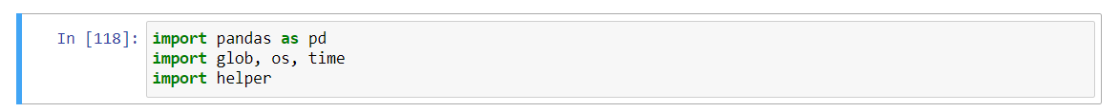
Steps we done so far…
Preprocessing the data
After collecting all data, next step involves preprocessing or cleaning the data for which the pandas and numpy libraries can easily understand.
Here we used pandas library that we discussed earlier
In addition we also used glob, os, time and helper

Slide 11
Preprocessing the data
Glob
The glob is a python module that finds all the pathnames matching a specified pattern according to the rules used by the Unix shell, although results are returned in arbitrary
order. No tilde expansion is done, but *, ?, and character ranges expressed with
[] will be correctly matched.
This is done by using the os.scandir() and fnmatch.fnmatch() functions in concert, and not by actually invoking a subshell. Note that unlike fnmatch.fnmatch(), glob treats filenames beginning with a dot (.) as special cases. (For tilde and shell variable expansion,
use os.path.expanduser() and os.path.expandvars().)
For a literal match, wrap the meta-characters in brackets. For example, '[?]' matches the character '?'.

Slide 12
Preprocessing the data
OS python module
This module provides a portable way of using operating system dependent functionality.
If you just want to read or write a file see open(), if you want to manipulate paths,
see the os.path module, and if you want to read all the lines in all the files on the command line see the fileinput module.
For creating temporary files and directories see the tempfile module, and for high-level file and directory handling see the shutil module.
The design of all built-in operating system dependent modules of Python is such that as long as the same functionality is available, it uses the same interface;
for example, the function os.stat(path) returns stat information about path in the same format (which happens to have originated with the POSIX interface).
Extensions peculiar to a particular operating system are also available through the os module, but using them is of course a threat to portability.

Slide 13
Preprocessing the data
Time python module
This module provides various time-related functions. For related functionality, see also the datetime and calendar modules.
Although this module is always available, not all functions are available on all platforms. Most of the functions defined in
this module call platform C library functions with the same name. It may sometimes be helpful to consult the platform documentation,
because the semantics of these functions varies among platforms.

Slide 14
Preprocessing the data
Helper python module
helper is a command-line/daemon application wrapper package with the aim of creating a consistent and fast way to creating applications. It is available on the Python Package Index as helper. helper supports both UNIX (Posix) and Windows applications (in process) and works with Python 2.6+ and 3.2+.
To use helper module you need to install in your system using PIP

Slide 15
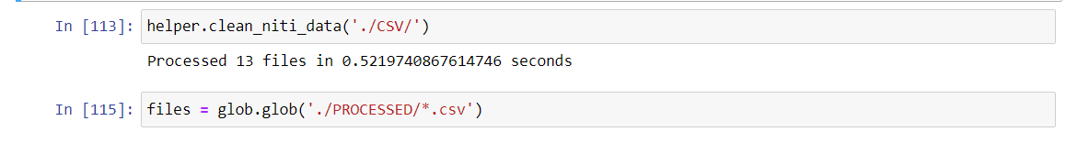
Preprocessing the data
Next step is fetching the dataset from the directory, this step is quite straight forward.
And also we created a variable to store the processed data. Usually this variable contain directory.

Slide 16
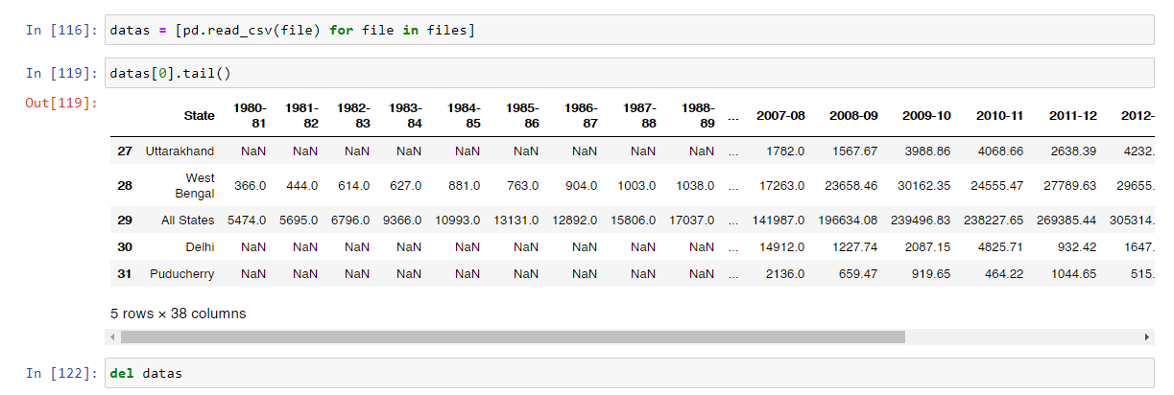
Preprocessing the data
Next step is Reading the dataset from files and checking whether the dataset containing any null values or missing values or unknown datatype entries.

Slide 17
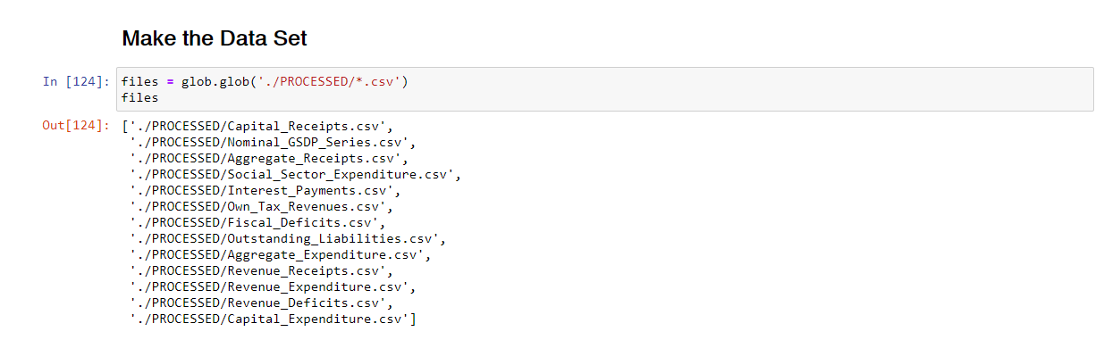
Preprocessing the data
Next step is making the data set from remaining 13 files. For this we fetched all the datasets at a time.

Slide 18
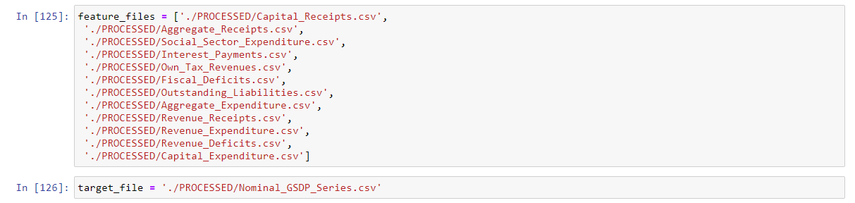
Preprocessing the data
Next step is storing feature set files location in a list for future use.
And also created a target variable for output.

Slide 19
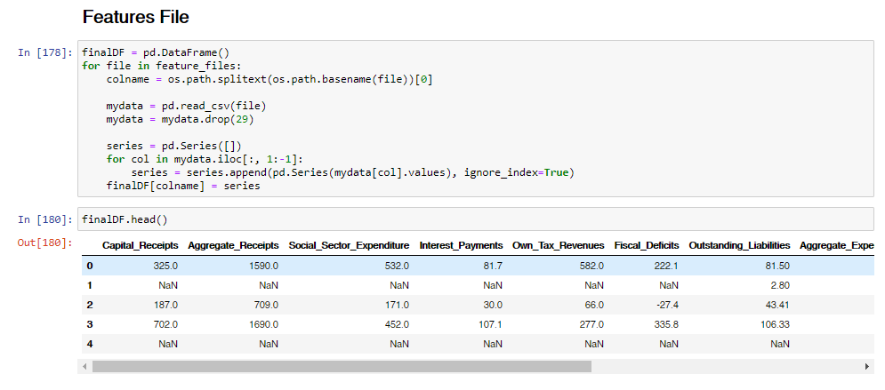
Preprocessing the data
Next step is setting feature values in the csv file for future uses.

Slide 20
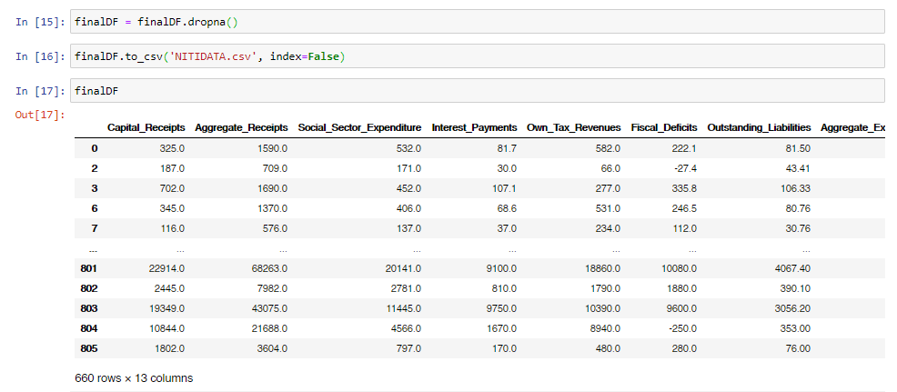
Preprocessing the data
Next step is removing null values from the resultant dataset

Slide 21
Future steps
So far we done preprocessing or cleaning the data and making feature sets for the future use.
Our next step is selecting the effective machine learning model or deep learning model which gives accurate output.
Train and test data splitting
Prediction
Tuning it for increasing the accuracy
Final conclusion

Slide 22
References
https://en.wikipedia.org/wiki/Gross_domestic_product
https://www.investopedia.com/articles/investing/050515/how-gdp-india-calculated.asp
https://machinelearningmastery.com/deep-learning-for-time-series-forecasting/
https://dspace.mit.edu/handle/1721.1/109649
https://numpy.org/doc/stable/user/quickstart.html
https://pandas.pydata.org/

Slide 23
Thank you

